Slide 1

Face Mask Detection Using Deep Learning
by
B. Padmini
Roll No. 184G1A0555
P. Manasa
Roll No. 184G1A0541
M. Lakshmi Jyoshna
Roll No. 184G1A0532
G. Aravind
Roll No. 184G1A0503
S. Muni vinod
Roll No. 194G5A0505
Under the guidance of
Dr. B. HariChandana M.Tech.Ph.D
Assistant Professor
Department of Computer Science and Engineering
Srinivasa Ramanujan Institute of Technology
(Affiliated to JNTUA & Approved by AICTE) (Accredited by NAAC with ‘A’ Grade & Accredited by NBA (EEE, ECE & CSE)
Rotarypuram Village, B K Samudram Mandal, Ananthapuramu – 515701.
2021 - 2022

Slide 2
Introduction
It is true COVID-19 is a global pandemic and affects several domains.Neverthless,it created a path for researchers in computer science.
With the help of deep learning algorithms, we can build a model which recognizes the face and detects the mask.
CNN(convolutional neural networks) is mainly used for image processing and image recognization.
CNN is type of deep learning neural network .The main advantage is it automatically detects the important features without any human super vision.

Slide 3
Existing System
After lockdown ,It has become so difficult to control the public gatherings,especially in educational institutions and in workplaces.Hence face masks are made compulsory.
Previously a model for non-masked face recognition and masked face recognition accuracy using Principal Component Analysis (PCA) to recognize a person.
But there are some drawbacks using PCA as the recognition rate is good for only non masked face.
This makes this model less efficient and less accurate. Hence there is a scope for the emergence of new model.

Slide 4
Proposed System
To overcome the difficulty of the existing system, we build a model using some Machine learning algorithms.
We use convolutional neural networks(CNN) majorly.
This models is built to make accurate and optimal results.
Images
Cascade Classifier
CNN Algorithm
Data sets
Features Learning
Data sets training
.MODEL
Image capture
(Eyes,nose,mouth)
With Mask
Without Mask

Slide 5
Literature Survey
1-[Ankit V Ponkia, Jitendra Chaudhari]:This paper represents an implementation of Principal Component Analysis (PCA) on masked and non masked face recognition.
2-[A.Kumar,A.Kaur,M.Kumar]: This paper focuses on presenting information about Deep learning.By the development of face mask detection we can detect if the person is wearing a face mask or not.
3-[P. Viola and M. J. Jones]: This paper focuses on basic Convolutional Neural Network (CNN) model is built using TensorFlow, Keras, Scikit-learn and OpenCV to make the algorithm as accurate as possible

Slide 6
Problem Definition
Virus has not left us yet. There are new variant of virus everyday due to many uncontrollable scenarios.
So, is necessity to monitor people whether they are wearing masks or not.
This not only ensures the public safety but also helps us in preventing the new variants.
We must ensure the risk control in the great way in order to resolve this issue.
This is a deep learning-based approach for detecting masks over faces in public places to curtail the community spread of coronavirus is the efficient method.
The proposed technique can be integrated into any high-resolution video surveillance devices and not limited to mask detection only.

Slide 7
Requirements
Hardware Requirements:
Processor : I3/Intel Processor
RAM : 8GB
Hard Disk : 128GB
software Requirements:
Operating System : Windows 10
Server Side Script : Python 3.6
Libraries Used : Numpy,keras,Pandas,Tenserflow

Slide 8
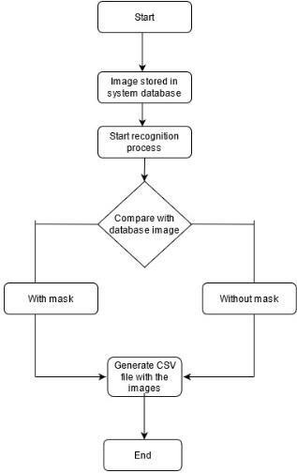
Data Flow Diagram
Data Flow Diagram

Slide 9
Module Description
The entire project is divided into several modules in which they are dependent on one other. Each module perform unique work in the implementation of the project. They are :
Data collection
Data Preprocessing
Model Creation
Model Training
Model Evaluation

Slide 10
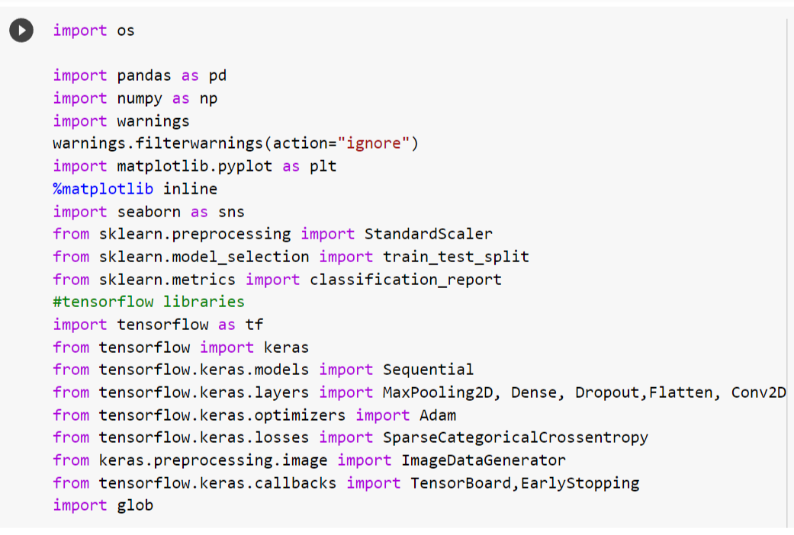
Sample Code:-Data Collection
Importing libraries:

Slide 11
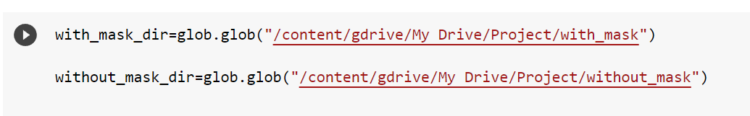
Contd…
Dataset:

Slide 12
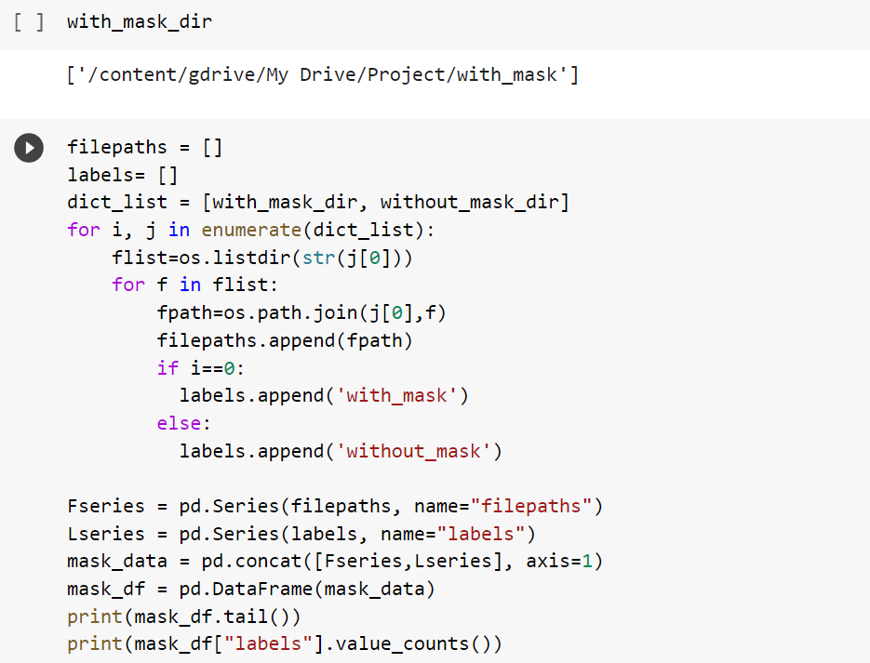
Data Preprocessing:

Slide 13
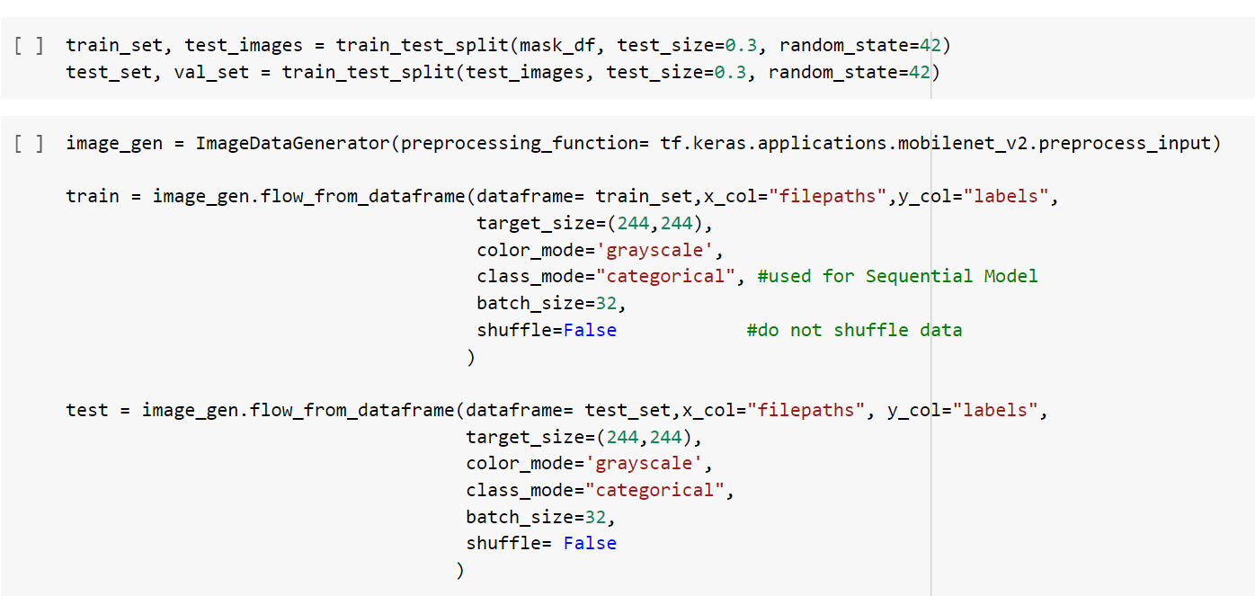
Contd…

Slide 14
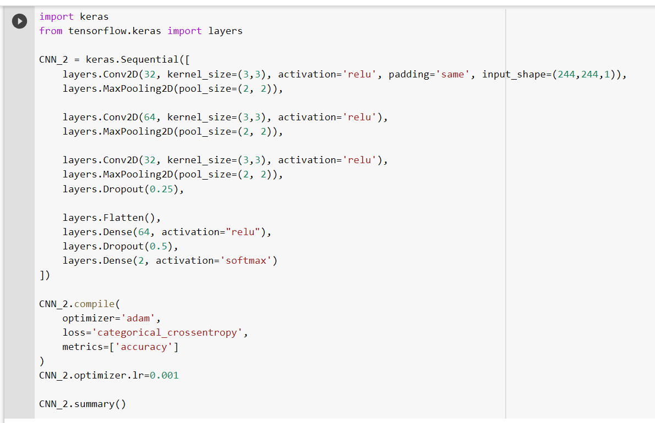
Model Creation:

Slide 15
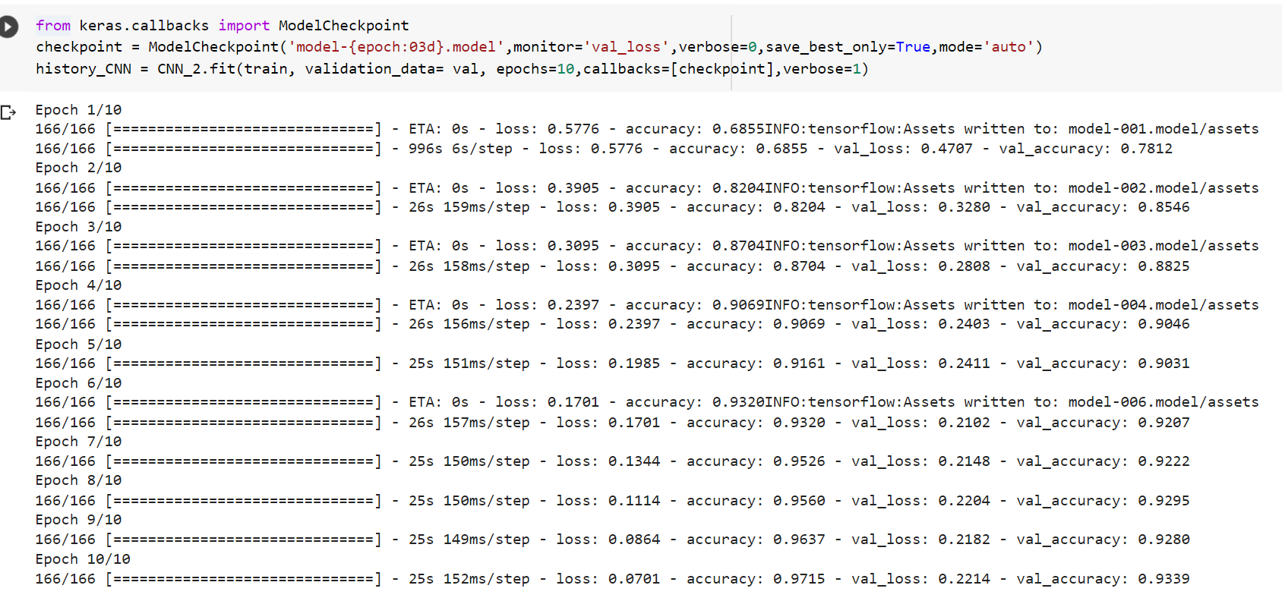
Model Training:

Slide 16
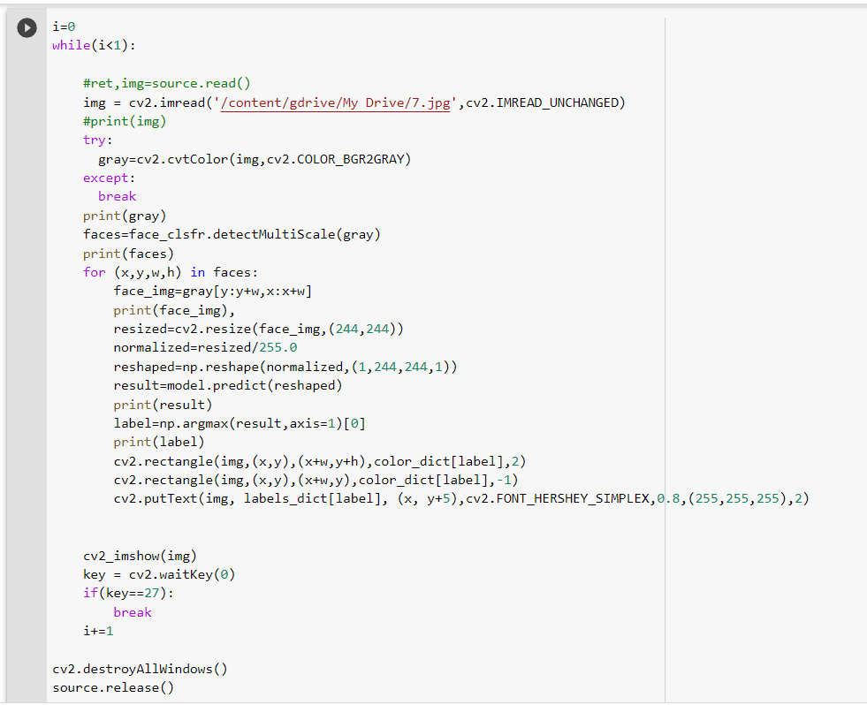
Model Evaluation:

Slide 17
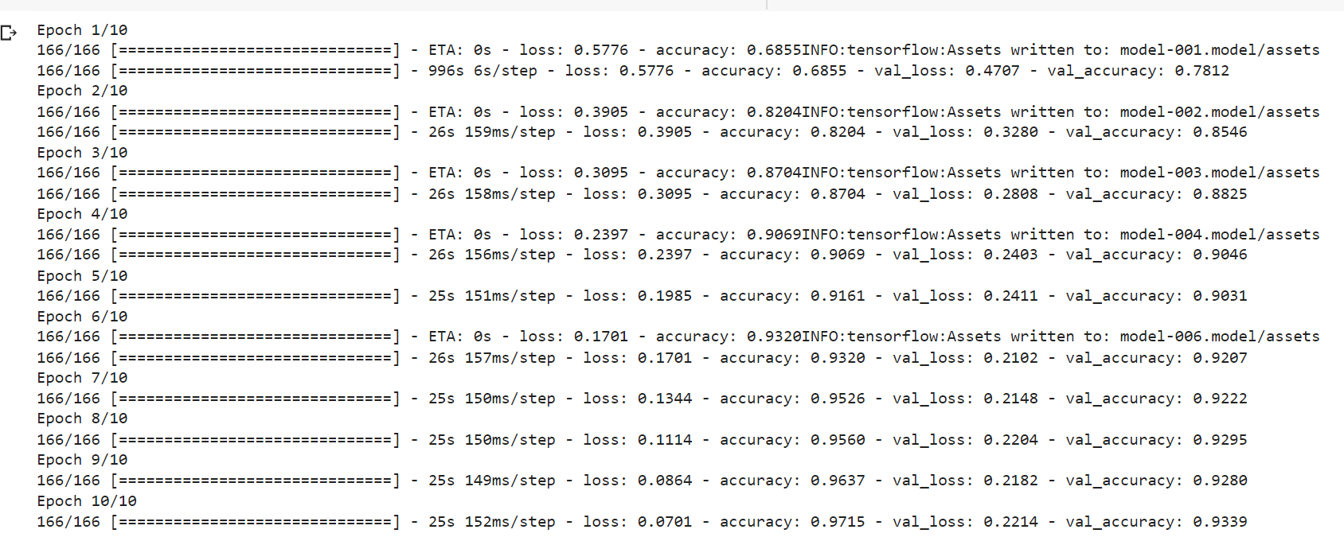
Screenshot:-

Slide 18
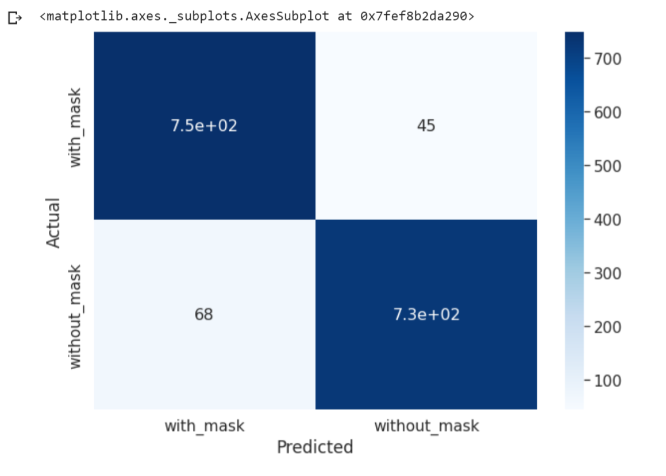
Actual Vs Predicted:

Slide 19
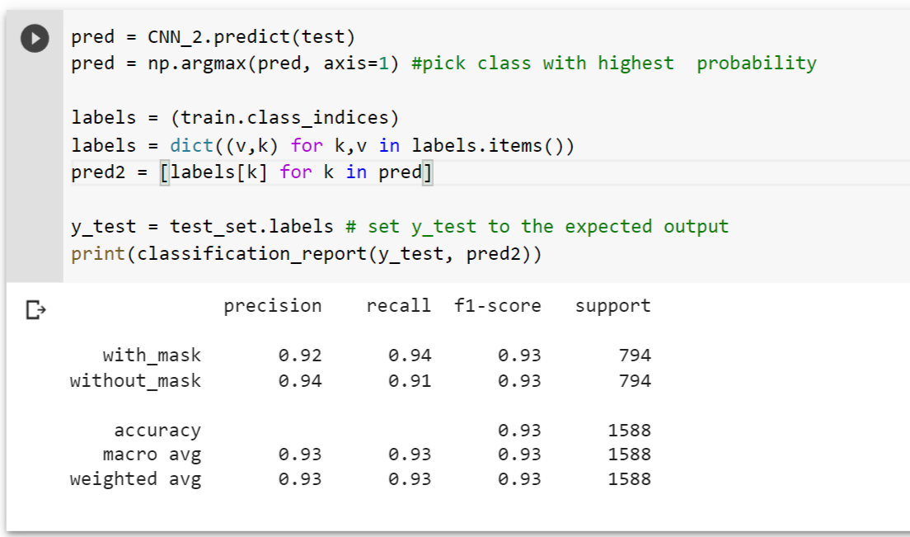
Predicted Output:

Slide 20
Conclusion
This model is a face mask recognition system for images that automatically identifies if a person is wearing a mask or not.which is an excellent solution for deterring the spread of the COVID-19 pandemic. By using Keras and CNN, the proposed system is able to detect the presence or absence of a face mask and the model gives precise and quick results. The trained model yields an accuracy of around 91%-93%.
Trials were conducted to compare it with other pre-existing popular models which demonstrates that the proposed model performs better in terms of processing time and accuracy. This methodology is an excellent contender for a real-time monitoring system because of its precision and computing efficiency.

Slide 21
References
[1] A.Matin,F.Mahmud, and T.Ahmed , International Conference on Electrical,Computer and Communication Engineering(EECE), vol. 2, pp. 1-4, Feb. 2017. ICASERT_Paper_688 (1).pdf
[2] Z.-Q. Zhao, P. Zheng, S.-t.Xu, and X. Wu, Object detection with deep learningIEEE transactions on neural networks and learning systems 2019.covid-19-facemask-detection-with-deep-learning-and-computer-vision-IJERTCONV9IS05017.pdf
[3] P.Viola and M. J. Jones "Robust real-time face detection" Int. J.
Comput. Vision vol. 57 no. 2 pp. 137-154 May 2004.kodali2021.pdf
[4] https://www.analyticsvidhya.com/

Slide 22
contd...
[5] https://www.analyticsvidhya.com/blog/2021/05/convolutional-neural- networks-cnn/
[6] 9Bc6hwlvheb7B606.pdf

Slide 23
Thank You!!!

